Slide 1



MyWay Overview & innovation challenges
Francesc Varela
CEO
1st MOVESMART WORKSHOP Bilbao, 15th October 2015

Slide 2
Contents
MyWay outline
The project
Objectives
Living Labs
MyWay innovation challenges
Metapplaner
User centric approach (user & context dependent)
Trip Follower
Architecture & clients

Slide 3
Myway outline
Multimodal mobility services for the smart city: the MyWay innovation challenges

Slide 4
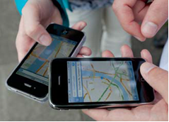











THE PROJECT
Enhancing personal urban mobility through smart services
Part- funded under FP7 – ICT
Smart Cities call (DG CNECT)
30 months, start: September 2013
ICT solutions & service providers
Research organisations
Local Authorities and stakeholders
Notes:
The MyWay project is co-founded by EC under the SMARTCITIES call. The project kick off on 1° September 2013 and will end on February 2016 for a total of 30 months. It comprises ICT solution providers, universities and research organizations & local authorities and stakeholders.

Slide 5
OBJECTIVES
Expected feature of MyWay platform (from DoW
and Functional & Non-Functional Requirements):
Propose to the user a multimodal journey fitting his/her needs (time, purpose, conditions, context, etc..)
Use a variety of public and private transport modes
Take into account, adapting or refining the trip, contextual information
Integrate booking and billing services from the transport operators
Learn from the expectations and preferences of the traveller

Slide 6



LIVING LAB VALIDATION
Barcelona/Catalonia. Urban and regional mobility, highly personalised multi-modal travel services: bus/metro/train, DRT schemes, bike sharing, EV scooter sharing (MOTIT).
Local stakeholders: GENCAT, ATM, Going Green
Berlin. Intermodal travel services, real-life tests and scenario evaluation through simulation (future mobility); intermodal info services (bus/metro/train), car sharing, bike sharing
Local stakeholders: VMZ Berlin, FhG FOKUS Lab
Trikala (GR). Mid-size town, regional seasonal peak mobility, elderly services, students mobility; regular PT, private mobility, spontaneous social mobility (car pooling). Evaluation of scalability of services
Local stakeholders: e-Trikala, ICCS
Notes:
How the project is been validated?
The validation will be made in 3 different Living Labs: Barcelona/catalonia Region, Berlin and Trikala. The three living labs differ for size, traveller bahviour and mobility offering and will give the oportunity to test and evaluate the MyWya platform in different situation.

Slide 7
INNOVATION challenges
Multimodal mobility services for the smart city: the MyWay innovation challenges

Slide 8
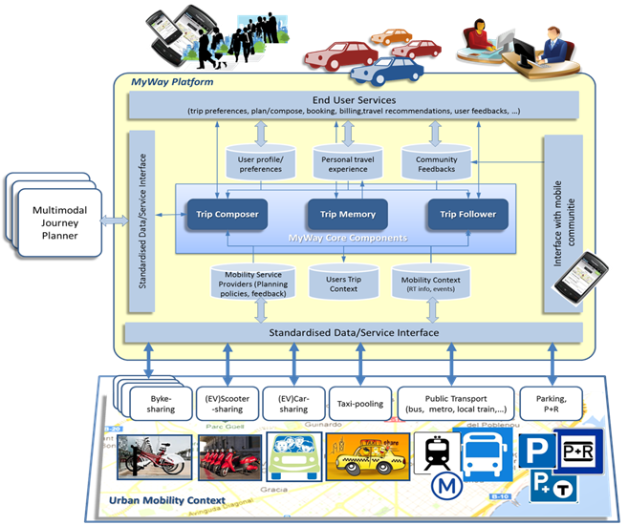
Architecture APPROACH
Offering end-user services via Open API
Re-using existing services via standard-based APIs and SDKs
Urban ITS standardised data/service interface
JP standardised service interface
Interface with mobile communities and crowd sourcing services
Notes:
The MyWay platform has been conceived to offer scalability applying modulariation, loose coupling and support exploitation through the support of different deployment models. The MyWay core components, which includes the main business layer part, is feeded through the link to existing services and data.
The main innovations point of the project are delivered through the 3 core components of the architecture: Trip Composer, Trip Memory and Trip Follower

Slide 9
INNOVATION CHALLENGES
Trip composer. Meta planner approach: re-using existing JP instead of implementing a new one.
Trip memory. User centric approach. Learning user preferences from his behaviour. Offer personalized solutions depending on the user and the context.
Trip follower. Helping the user during the trip with real time info.
1
2
3

Slide 10
1
META PLANNER
Trip Composer:
Fully multimodal
Combination of public and private services
Combination of personal and shared modes
Combination of traditional and new (or soft) modes.
Re-use of existing and external resources (JPs, ITS services)
Meta-planning level
context aware
user profile/experience
standardised interfaces (JPs, ITS services)
→ supporting LAs’ policies (scoring)
1
1
1

Slide 11

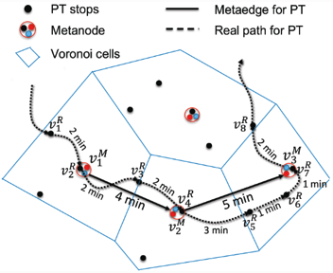
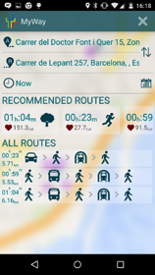











META PLANNER
INTERFACES
TRIP PLANNER

Slide 12
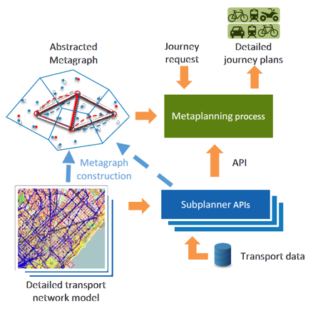
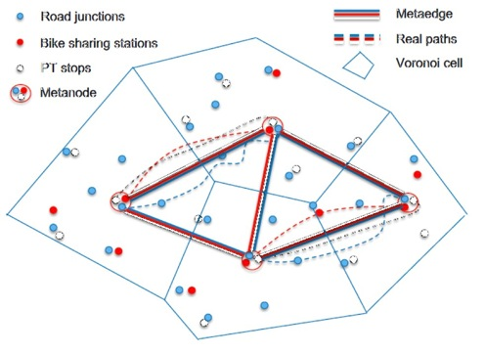
META PLANNER

Slide 13
2
TRIP MEMORY
Trip Memory:
Learning the user mobility behaviour from trip follower. Does the user follow MyWay recommendations? Always? Sometimes? Depending on what? (choices, preferences)
Updating user preferences with his real decisions.
Collecting user experience over time (qualitative satisfaction)
→ adapting travel planning/offer (Composer) to user travel experience
2
2

Slide 14
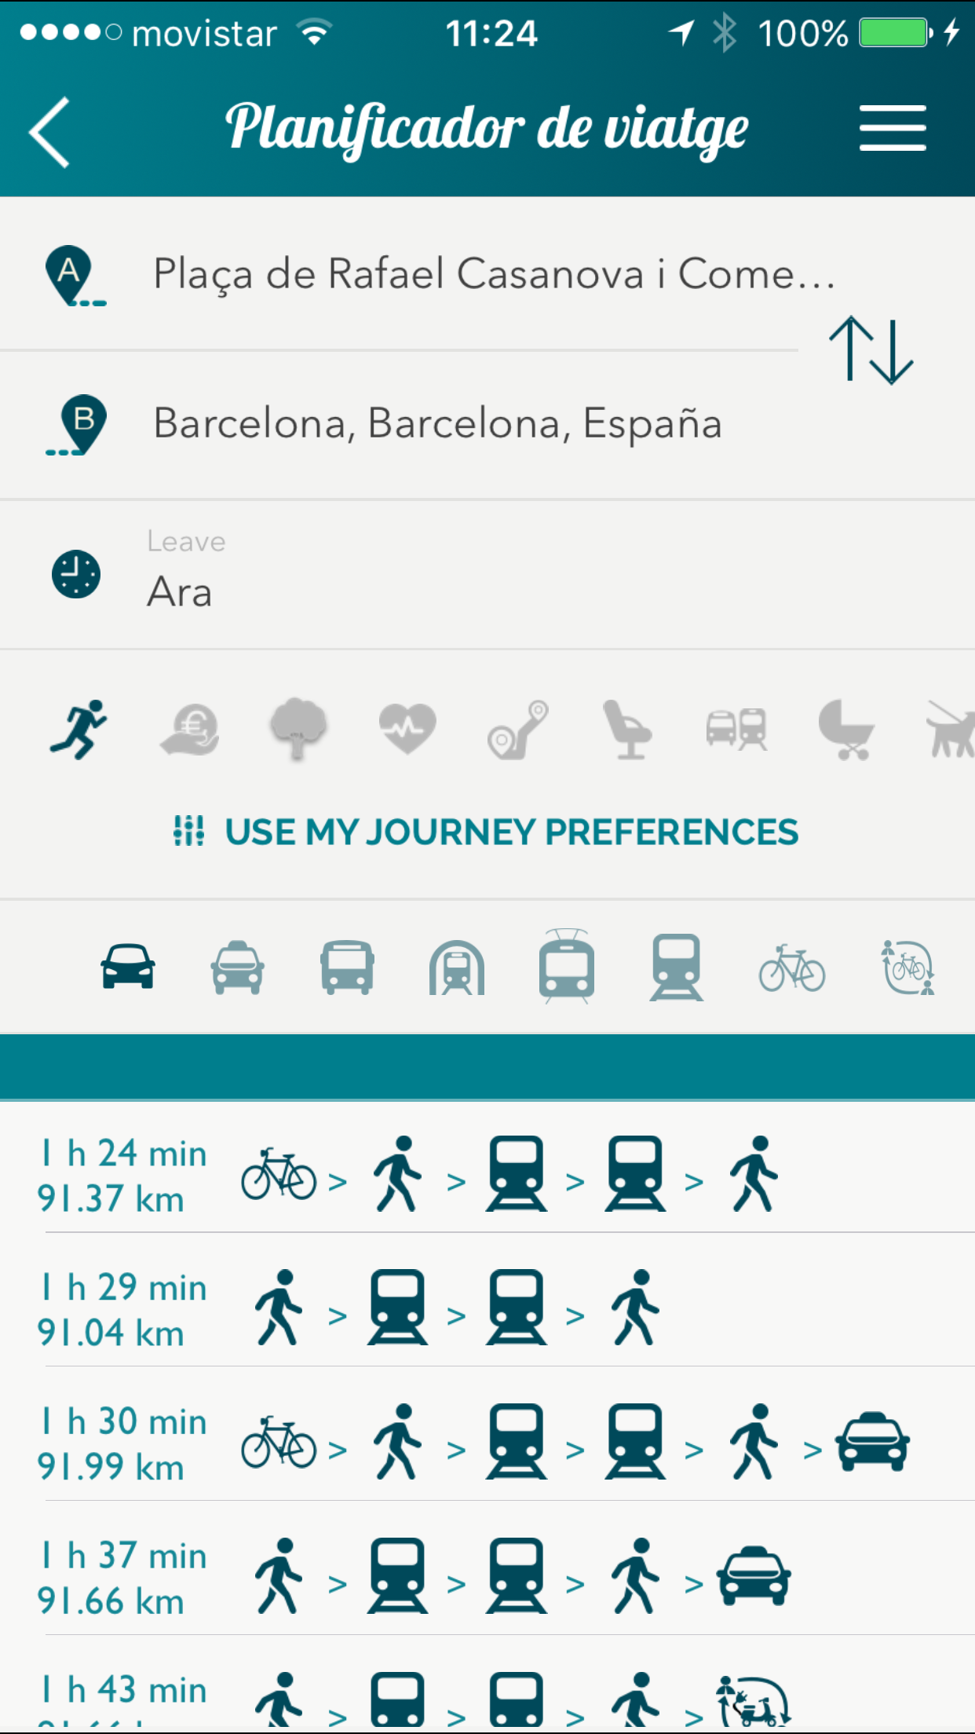
TRIP MEMORY
city & transport context
Trip Composer
Metaplanner
scored solutions
User profile
default / specific
translator
scorer
parameterized requests
trip memory learning
external JP

Slide 15
3
TRIP FOLLOWER
Trip Follower:
Active trip monitor, to help or guide the user during the trip.
Real-time alerts, caused by disruptions, delays, the context
Replanning if needed, because of disruptions or delays.
mobility context (ITS serv.)
users community (direct feedbacks)
→ users can be proactive elements of travel adaptation
3
3

Slide 16
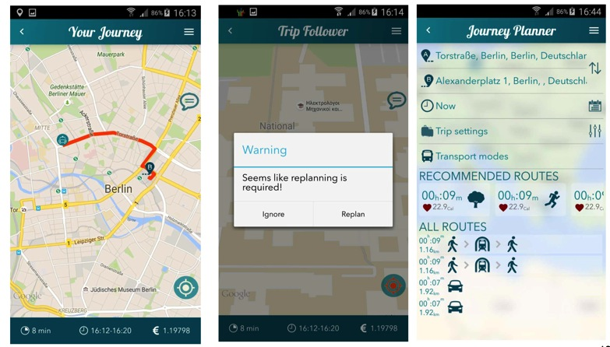
TRIP FOLLOWER

Slide 17
INNOVATION ACHIEVEMENTS
Trip composer. Meta planner approach: re-using existing JP instead of implementing a new one.
Trip memory. User centric approach. Learning user preferences from his behaviour. Offer personalized solutions depending on the user and the context.
Trip follower. Helping the user during the trip with real time info.

Slide 18
ARCHITECTURE & CLIENTS
Multimodal mobility services for the smart city: the MyWay innovation challenges

Slide 19
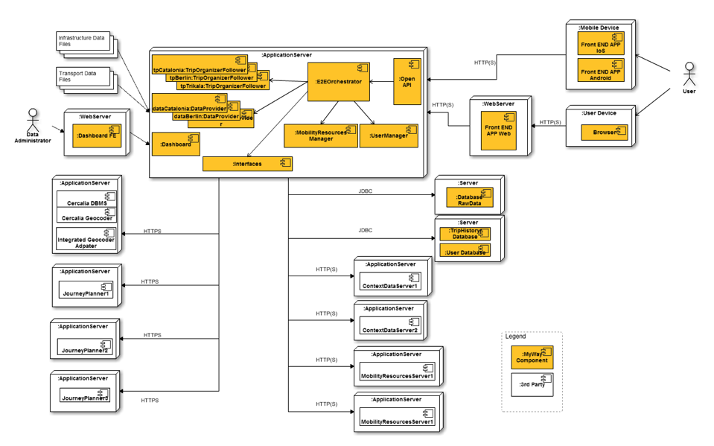
HIGH LEVEL ARCHITECTURE

Slide 20
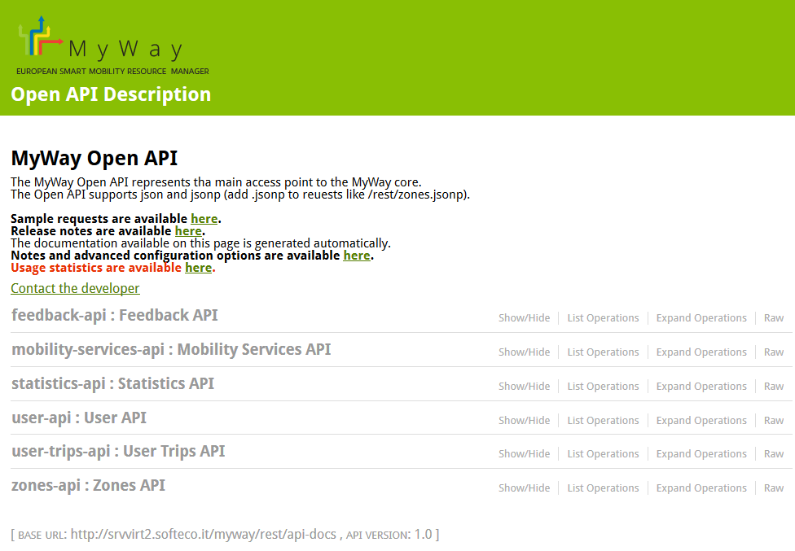
OPEN-API
Rest interface to exploit MyWay backend features on the clients

Slide 21
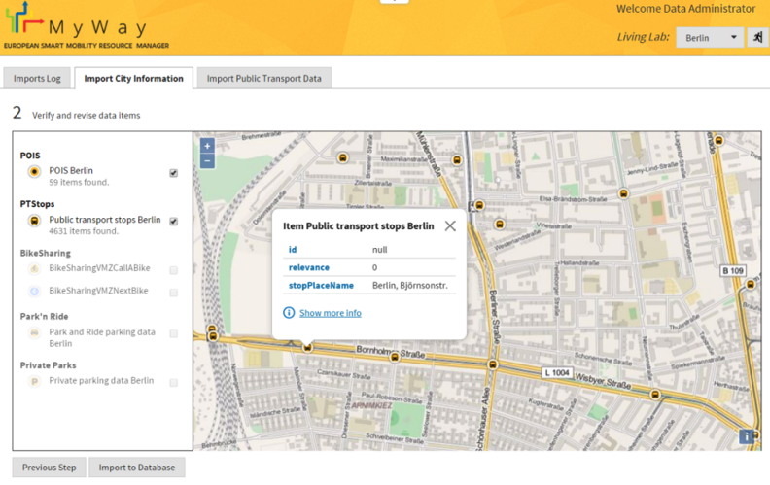
FRONTENDS - DASHBOARD
Web Interface for Data Administrator

Slide 22
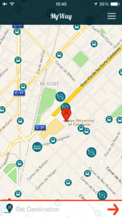
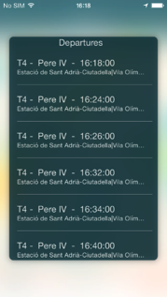
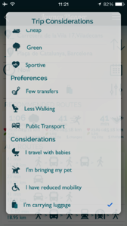
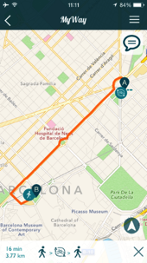
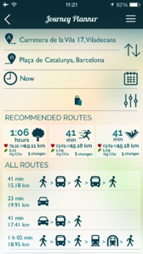

FRONTENDS – iOS
Native App for Apple devices (iOS 8 or later)

Slide 23
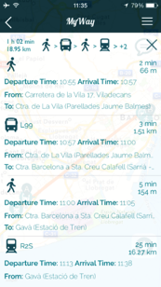
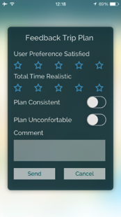
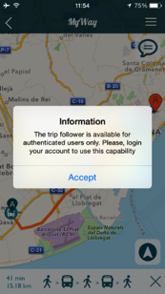
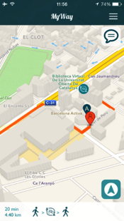
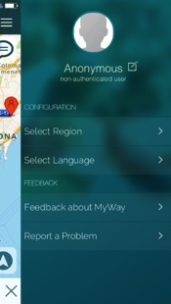
FRONTENDS – iOS (2)
Native App for Apple devices (iOS 8 or later)

Slide 24
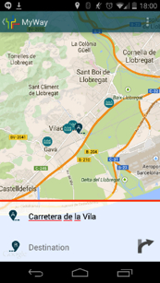
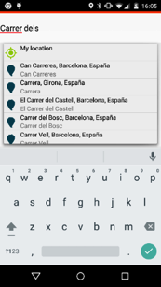
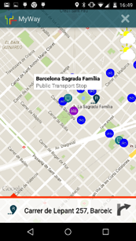
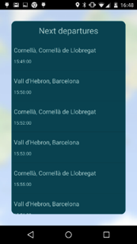
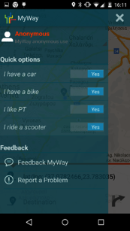

FRONTENDS – ANDROID
Native App for Android devices (4.2.1 or later)

Slide 25
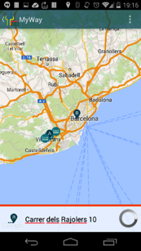
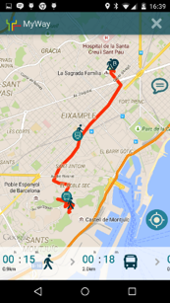
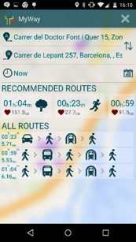
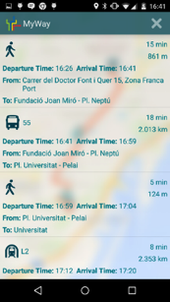
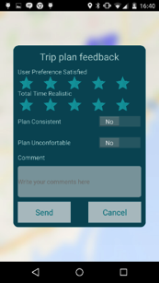
FRONTENDS – ANDROID (2)
Native App for Android devices (4.2.1 or later)

Slide 26

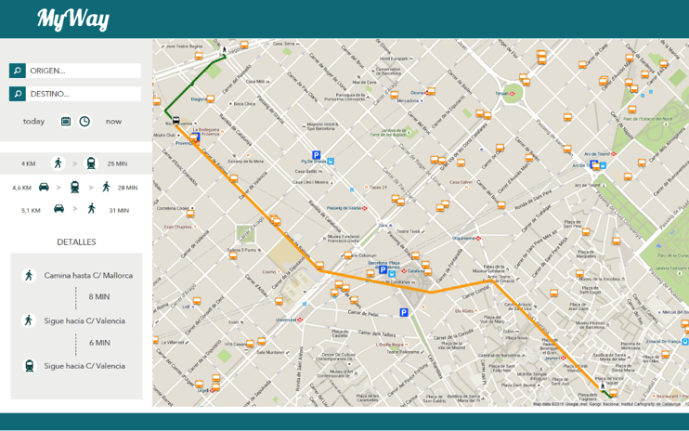
FRONTENDS – WEB CLIENT

Slide 27

Francesc Varela
CEO
Nexus Geografics
fvarela@ngeografics.com
This project has received funding from the European Union’s Seventh Framework Programme for research, technological development and demonstration under grant agreement no 609023

